Slide 1


Department of Computer Science and Engineering
CS191P11 –IOT
SMART SENSING ROVER
SOWMYA R - 230701328
SOUNDARYALAKSHMI S - 230701326

Slide 2
ABSTRACT
The Smart Sensing Rover is an IoT-enabled robotic vehicle designed to assist in identifying and locating people in emergency or inaccessible land-based environments. The rover is equipped with a variety of sensors including an ultrasonic sensor for obstacle avoidance, a sound sensor to detect human voices or distress noises, an infrared (IR) sensor to sense human presence through heat or motion. The primary aim of the rover is to aid in early detection and rapid response in situations such as natural disasters, remote area incidents, or hazardous environments. By combining multi-sensor input and wireless communication, the Smart Sensing Rover serves as a mobile support system to enhance safety, speed up rescue operations, and provide situational awareness without putting rescuers at risk.

Slide 3
Introduction
The Smart Sensing Rover is an IoT-based robotic system developed to detect and assist people in land-based situations where visibility or accessibility is limited. This mobile rover is designed to navigate autonomously while collecting environmental and human-related data through a set of integrated sensors. It includes an ultrasonic sensor to avoid obstacles, a sound sensor to detect voices or noise, an infrared (IR) sensor for heat or motion detection, and a camera module to capture visual data. The system which processes the sensor inputs and transmits real-time notifications and media via Wi-Fi.
The main objective of this project is to create a smart, responsive system that can help identify the presence of people in need, provide visual confirmation to responders, and ensure safer, faster intervention without putting rescuers in direct danger. This rover acts as an intelligent assistant, contributing to modern solutions for disaster management, remote monitoring, and human safety operations.

Slide 4
Problem Statement
The goal is to develop a smart sensing rover for land-based human assistance. It is designed to detect obstacles, human presence, and environmental sounds while navigating autonomously through challenging terrains. The system integrates a camera module to capture real-time images or video and provides instant alerts to support emergency response and rescue operations efficiently.

Slide 5
Proposed Work
The Smart Sensing Rover will use an ultrasonic for obstacle detection, sound for distress signals, and IR for human presence detection.
The rover will integrate an module to capture real-time images or videos and send alerts through Wi-Fi for emergency response.
It will navigate autonomously in challenging terrains, using the sensor data to ensure safe operation and assist in human detection during critical situations.

Slide 6
Implementation
The rover is built using an ultrasonic sensor, sound sensor, IR sensor all assembled on a mobile platform and programmed for autonomous operation.
It navigates through terrain while detecting obstacles, human presence (via IR), and distress sounds, and captures real-time images or video .
Upon detecting a person or alert condition, it transmits notifications and visual data via Wi-Fi to a connected device, assisting in real-time monitoring and emergency response.

Slide 7
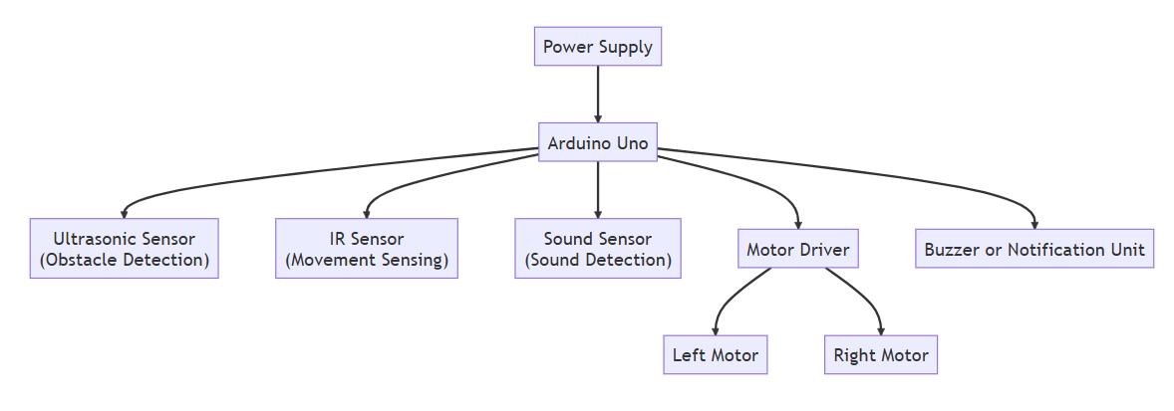
Architecture

Slide 8
System requirements
Arduino UNO software
Ultrasonic sensor
Sound sensor
IR sensor
Motor

Slide 9
Advantages of the proposed system
Reduces human risk by operating in dangerous or hard-to-reach areas.
Works autonomously, reducing the need for manual control.
Provides real-time updates, helping responders act quickly.
Uses affordable components, making it cost-effective and accessible.
Supports faster and safer response in emergency situations.
Can be adapted for various land-based monitoring and assistance tasks.

Slide 10
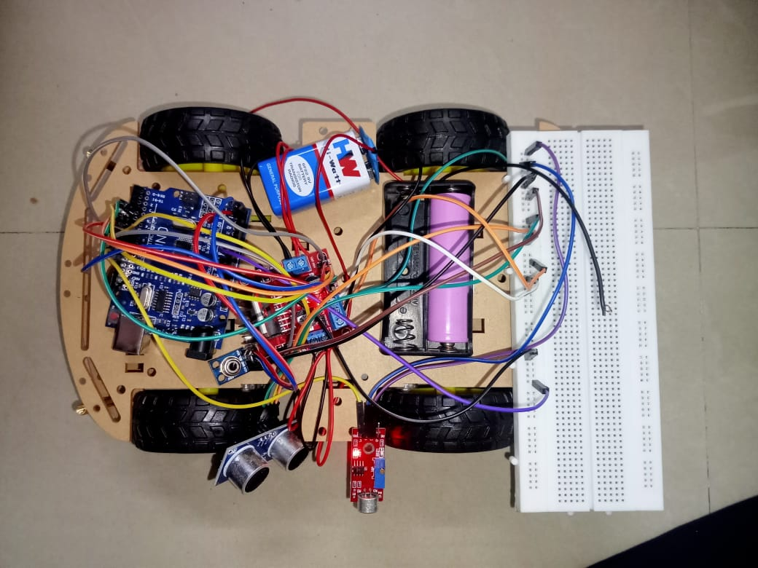
Smart Sensing Rover

Slide 11
Implementation of Rover
The implementation of the IoT-based rescue rover involves integrating multiple sensors and components to enable autonomous navigation, environmental monitoring, and real-time communication. The rover is designed to assist in search-and-rescue operations by detecting obstacles, identifying potential victims, and transmitting relevant data to a remote interface.
The rover is built with the following key components:
Ultrasonic Sensor: Positioned at the front to measure the distance between the rover and nearby objects, helping it detect and avoid obstacles during navigation.
IR Sensor: Used for proximity and edge detection to ensure the rover avoids unsafe paths such as ledges or drop-offs.
Sound Detector: Continuously monitors for sound patterns such as human cries or calls for help, triggering alerts when such signals are identified.

Slide 12
Implementation of Rover
1.A suitable microcontroller is programmed to read data from the sensors and control the movement of DC motors via a motor driver. Based on sensor input, the rover makes real-time decisions—such as stopping, turning, or sending alerts.
2.The rover connects to a web-based monitoring system via standard wireless communication protocols, allowing real-time visualization of sensor data and rover activity. The system notifies rescue operators immediately upon detecting sound signals or critical changes in the environment.
Powered by a rechargeable battery and built on a mobile chassis, the rover is compact, efficient and capable of navigating debris-filled or hazardous areas, making it a reliable assistant in rescue missions.

Slide 13
Conclusion
The Smart Sensing Rover is a practical and innovative solution designed to assist in locating and monitoring people in emergency or inaccessible land areas. By integrating multiple sensors and real-time communication, the rover can navigate autonomously, detect human presence, and provide immediate visual and alert-based feedback. This system reduces the risk to human rescuers and improves the speed and efficiency of response efforts. With its low-cost and scalable design, the project demonstrates how smart technology can play a vital role in enhancing safety and emergency management.

Slide 14
References
[1] S. K. Gupta, A. Bansal, and A. S. Malik, “IoT based multi-sensor smart rescue robot using ESP32,” Proceedings of the 2020 International Conference on Smart Electronics and Communication (ICOSEC), Trichy, India, 2020, pp. 253–258.
[2] R. Singh and N. Sharma, “Design and development of an autonomous rescue robot for disaster management,” 2019 5th International Conference on Computing, Communication, Control and Automation (ICCUBEA), Pune, India, 2019, pp. 1–5.
[3] S. J. Prasad and D. R. Reddy, “IoT-based human detection robot using ESP32 and sensors,” 2021 IEEE International Conference on Robotics and Smart Manufacturing (RoSMa), Chennai, India, 2021, pp. 134–138.
[4] M. Jain, V. Sharma, and P. Patil, “Development of a real-time environment monitoring rover using IoT,” 2020 International Conference on Emerging Trends in Information Technology and Engineering (ic-ETITE), Vellore, India, 2020, pp. 1–5.
[5] A. S. Pawar and K. R. More, “Survivor detection using wireless sensor network for rescue operation,” 2018 International Conference on Communication and Signal Processing (ICCSP), Chennai, India, 2018, pp. 694–698.

Slide 15
Thank You

